Slide 1
Main Memory

Slide 2
Memory Management
Background
Swapping
Contiguous Memory Allocation
Segmentation
Paging
Structure of the Page Table

Slide 3
Objectives
To provide a detailed description of various ways of organizing memory hardware
To discuss various memory-management techniques, including paging and segmentation

Slide 4
Background
Program must be brought (from disk) into memory and placed within a process for it to be run
Main memory and registers are only storage CPU can access directly
Memory unit only sees a stream of addresses + read requests, or address + data and write requests
Register access in one CPU clock (or less)
Main memory can take many cycles, causing a stall
Cache sits between main memory and CPU registers
Protection of memory required to ensure correct operation

Slide 5
Base and Limit Registers
We first need to make sure that each process has a separate memory space.
Separate per-process memory space protects the processes from each other and is fundamental to having multiple processes loaded in memory for concurrent execution.
To separate memory spaces, we need the ability to determine the range of legal addresses that the process may access and to ensure that the process can access only these legal addresses.
We can provide this protection by using two registers, usually a base and a limit, as illustrated in Figure 1.
The base register holds the smallest legal physical memory address; the limit register specifies the size of the range.
For example, if the base register holds 300040 and the limit register is 120900, then the program can legally access all addresses from 300040 through 420939 (inclusive).

Slide 6

Base and Limit Registers
A pair of base and limit registers define the logical address space
CPU must check every memory access generated in user mode to be sure it is between base and limit for that user

Slide 7

Hardware Address Protection

Slide 8
Address Binding
To be executed, the program must be brought into memory and placed within a process.
Depending on the memory management in use, the process may be moved between disk and memory during its execution.
The processes on the disk that are waiting to be brought into memory for execution form the input queue.
The normal single-tasking procedure is to select one of the processes in the input queue and to load that process into memory.
As the process is executed, it accesses instructions and data from memory.
Eventually, the process terminates, and its memory space is declared available.

Slide 9
Address Binding
Programs on disk, ready to be brought into memory to execute form an input queue
  Without support, must be loaded into address 0000
Inconvenient to have first user process physical address always at 0000
  How can it not be?
Further, addresses represented in different ways at different stages of a program’s life
  Source code addresses usually symbolic
  Compiled code addresses bind to relocatable addresses
    i.e. “14 bytes from beginning of this module”
  Linker or loader will bind relocatable addresses to absolute addresses
    i.e. 74014
  Each binding maps one address space to another

Slide 10
Binding of Instructions and Data to Memory
Address binding of instructions and data to memory addresses can happen at three different stages
  Compile time: If memory location known a priori, absolute code can be generated; must recompile code if starting location changes
  Load time: Must generate relocatable code if memory location is not known at compile time
  Execution time: Binding delayed until run time if the process can be moved during its execution from one memory segment to another
    Need hardware support for address maps (e.g., base and limit registers)

Slide 11

Multistep Processing of a User Program

Slide 12
Logical vs. Physical Address Space
The concept of a logical address space that is bound to a separate physical address space is central to proper memory management
  Logical address – generated by the CPU; also referred to as virtual address
  Physical address – address seen by the memory unit
Logical and physical addresses are the same in compile-time and load-time address-binding schemes; logical (virtual) and physical addresses differ in execution-time address-binding scheme
Logical address space is the set of all logical addresses generated by a program
Physical address space is the set of all physical addresses generated by a program

Slide 13
Memory-Management Unit (MMU)
The run-time mapping from virtual to physical addresses is done by a hardware device called the memory-management unit (MMU).
For the time being, we illustrate this mapping with a simple MMU scheme that is a generalization of the base-register scheme
The base register is now called a relocation register.
The value in the relocation register is added to every address generated by a user process at the time the address is sent to memory
For example, if the base is at 14000, then an attempt by the user to address location 0 is dynamically relocated to location14000; an access to location346 is mapped to location 14346.

Slide 14

Dynamic relocation using a relocation register
The user program never sees the real physical addresses.
The program can create a pointer to location 346, store it in memory, manipulate it, and compare it with other addresses—all as the number 346.
Only when it is used as a memory address (in an indirect load or store, perhaps) is it relocated relative to the base register.
The user program deals with logical addresses. The memory-mapping hardware converts logical addresses into physical addresses

Slide 15
Dynamic loading.
It has been necessary for the entire program and all data of a process to be in physical memory for the process to execute.
The size of a process has thus been limited to the size of physical memory.
To obtain better memory-space utilization, we can use dynamic loading.
With dynamic loading, a routine is not loaded until it is called. All routines are kept on disk in a relocatable load format.
The main program is loaded into memory and is executed.
When a routine needs to call another routine, the calling routine first checks to see whether the other routine has been loaded.
If it has not, the relocatable linking loader is called to load the desired routine into
memory and to update the program’s address tables to reflect this change. Then control is passed to the newly loaded routine.
The advantage of dynamic loading is that a routine is loaded only when it is needed.
This method is particularly useful when large amounts of code are needed to handle infrequently occurring cases, such as error routines.

Slide 16
Dynamic Linking
We know that for the operating system code is considered read only, and separate from data. It seems logical then that if programs can not modify code and have large amounts of common code, instead of replicating it for every executable it should be shared between many executables.
With virtual memory this can be easily done. The physical pages of memory the library code is loaded into can be easily referenced by any number of virtual pages in any number of address spaces. So while you only have one physical copy of the library code in system memory, every process can have access to that library code at any virtual address it likes.
Thus people quickly came up with the idea of a shared library which, as the name suggests, is shared by multiple executables. Each executable contains a reference essentially saying "I need library foo". When the program is loaded, it is up to the system to either check if some other program has already loaded the code for library foo into memory, and thus share it by mapping pages into the executable for that physical memory, or otherwise load the library into memory for the executable.
This process is called dynamic linking because it does part of the linking process "on the fly" as programs are executed in the system.

Slide 17
Swapping
A process must be in memory to be executed. A process, however, can be swapped temporarily out of memory to a backing store and then brought back into memory for continued execution
Swapping makes it possible for the total physical address space of all processes to exceed the real physical memory of the system, thus increasing the degree of multiprogramming in a system.
Backing store – fast disk large enough to accommodate copies of all memory images for all users; must provide direct access to these memory images
Roll out, roll in – swapping variant used for priority-based scheduling algorithms; lower-priority process is swapped out so higher-priority process can be loaded and executed
Major part of swap time is transfer time; total transfer time is directly proportional to the amount of memory swapped
System maintains a ready queue of ready-to-run processes which have memory images on disk

Slide 18
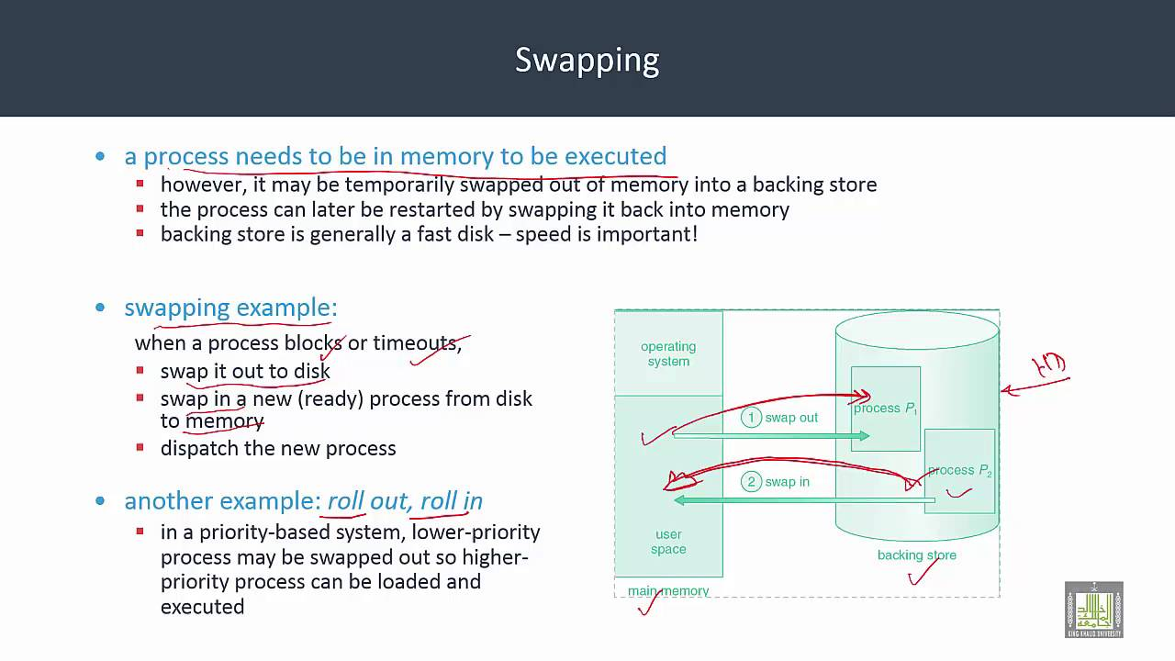

Slide 19

Schematic View of Swapping

Slide 20
Memory Allocation
Now we are ready to turn to memory allocation. One of the simplest methods for allocating memory is to divide memory into several fixed-sized partitions.
Each partition may contain exactly one process.
Thus, the degree of multiprogramming is bound by the number of partitions.
In this multiple partition method, when a partition is free, a process is selected from the input queue and is loaded into the free partition.
When the process terminates, the partition becomes available for another process.

Slide 21
Contiguous Allocation (Cont.)
In the variable-partition scheme, the operating system keeps a table indicating which parts of memory are available and which are occupied.
Initially, all memory is available for user processes and is considered one large block of available memory, a hole.
Eventually, as you will see, memory contains a set of holes of various sizes.

Slide 22

Hardware Support for Relocation and Limit Registers

Slide 23

Multiple-partition allocation
Multiple-partition allocation
  Degree of multiprogramming limited by number of partitions
  Variable-partition sizes for efficiency (sized to a given process’ needs)
  Hole – block of available memory; holes of various size are scattered throughout memory
  When a process arrives, it is allocated memory from a hole large enough to accommodate it
  Process exiting frees its partition, adjacent free partitions combined
  Operating system maintains information about:
  a) allocated partitions b) free partitions (hole)

Slide 24
Dynamic Storage-Allocation Problem
How to satisfy a request of size n from a list of free holes?
First-fit: Allocate the first hole that is big enough
Best-fit: Allocate the smallest hole that is big enough; must search entire list, unless ordered by size
  Produces the smallest leftover hole
Worst-fit: Allocate the largest hole; must also search entire list
  Produces the largest leftover hole
First-fit and best-fit better than worst-fit in terms of speed and storage utilization

Slide 25
Strategies of Memory Allocation
First fit. Allocate the first hole that is big enough.
Searching can start either at the beginning of the set of holes or at the location where the previous first-fit search ended.
We can stop searching as soon as we find a free hole that is large enough.
• Best fit. Allocate the smallest hole that is big enough.
We must search the entire list, unless the list is ordered by size.
This strategy produces the smallest leftover hole.
• Worst fit. Allocate the largest hole.
Again, we must search the entire list, unless it is sorted by size.
This strategy produces the largest leftover hole, which may be more useful than the smaller leftover hole from a best-fit approach.

Slide 26
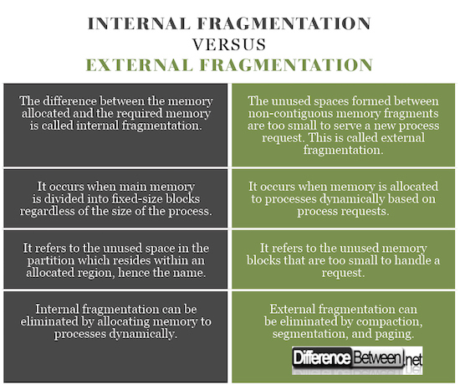

Slide 27
Fragmentation
External Fragmentation – total memory space exists to satisfy a request, but it is not contiguous
Internal Fragmentation – allocated memory may be slightly larger than requested memory; this size difference is memory internal to a partition, but not being used
First fit analysis reveals that given N blocks allocated, 0.5 N blocks lost to fragmentation
  1/3 may be unusable -> 50-percent rule

Slide 28
Fragmentation-External
Both the first-fit and best-fit strategies for memory allocation suffer from external fragmentation.
As processes are loaded and removed from memory, the free memory space is broken into little pieces.
External fragmentation exists when there is enough total memory space to satisfy a request but the available
spaces are not contiguous: storage is fragmented into a large number of small
holes.
This fragmentation problem can be severe. In the worst case, we could have a block of free (or wasted) memory between every two processes.
If all these small pieces of memory were in one big free block instead, we might be able to run several more processes.

Slide 29
Internal Fragmentation
Memory fragmentation can be internal as well as external.
Consider a multiple-partition allocation scheme with a hole of 18,464 bytes. Suppose that the next process requests 18,462 bytes.
If we allocate exactly the requested block, we are left with a hole of 2 bytes. The overhead to keep track of this hole will be substantially larger than the hole itself.
The general approach to avoiding this problem is to break the physical memory into fixed-sized blocks and allocate memory in units based on block size.
With this approach, the memory allocated to a process may be slightly larger than the requested memory.
The difference between these two numbers is internal fragmentation—unused memory that is internal to a partition.

Slide 30
Compaction
One solution to the problem of external fragmentation is compaction.
The goal is to shuffle the memory contents so as to place all free memory together in one large block. Compaction is not always possible, however.
If relocation is static and is done at assembly or load time, compaction cannot be done.
It is possible only if relocation is dynamic and is done at execution time.
If addresses are relocated dynamically, relocation requires only moving the program and data and then changing the base register to reflect the new base address.

Slide 31
Segmentation
Memory-management scheme that supports user view of memory
A program is a collection of segments
  A segment is a logical unit such as:
main program
procedure
function
method
object
local variables, global variables
common block
stack
symbol table
arrays

Slide 32
Examples
When writing a program, a programmer thinks of it as a main program with a set of methods, procedures, or functions.
It may also include various data structures: objects, arrays, stacks, variables, and so on. Each of these modules or data elements is referred to by name.
The programmer talks about “the stack,” “the math library,” and “the main program” without caring what addresses in memory these elements occupy.
She is not concerned with whether the stack is stored before or after the Sqrt() function.
Segments vary in length, and the length of each is intrinsically defined by its purpose in the program.
Elements within a segment are identified by their offset from the beginning of the segment: the first statement of the program, the seventh stack frame entry in the stack, the fifth instruction of the Sqrt(), and so on.

Slide 33

User’s View of a Program

Slide 34
Logical View of Segmentation
1
1
4
2
3
4
2
3
user space
physical memory space

Slide 35
Segmentation Architecture
Segmentation is a memory-management scheme that supports this programme rview of memory. A logical address space is a collection of segments.
Each segment has a name and a length. The addresses specify both the segment name and the offset within the segment.
The programmer therefore specifies each address by two quantities: a segment name and an offset.
For simplicity of implementation, segments are numbered and are referred to by a segment number, rather than by a segment name.
Thus, a logical address consists of a two tuple:
<segment-number, offset>.
Normally, when a program is compiled, the compiler automatically constructs segments reflecting the input program.
A C compiler might create separate segments for the following:
1. The code
2. Global variables
3. The heap, from which memory is allocated
4. The stacks used by each thread
5. The standard C library
Segment table – maps two-dimensional physical addresses; each table entry has:
  base – contains the starting physical address where the segments reside in memory
  limit – specifies the length of the segment
Segment-table base register (STBR) points to the segment table’s location in memory
Segment-table length register (STLR) indicates number of segments used by a program;
segment number s is legal if s < STLR

Slide 36
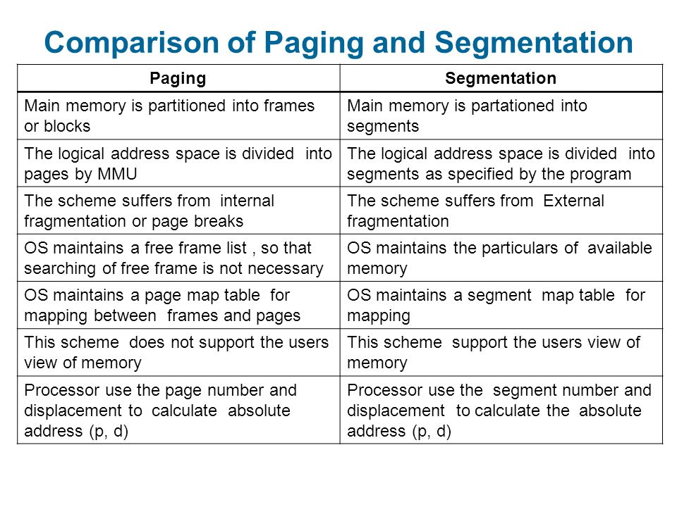

Slide 37
Segmentation Hardware
Each entry in the segment table has a segment base and a segment limit. The segment base contains the starting physical address where the segment resides in memory, and the segment limit specifies the length of the segment.
The use of a segment table is illustrated in Figure 8.8. A logical address
consists of two parts: a segment number, s, and an offset into that segment, d.
The segment number is used as an index to the segment table. The offset d of
the logical addressmust be between 0 and the segment limit. If it is not,we trap
to the operating system (logical addressing attempt beyond

Slide 38
As an example, consider the situation shown in Figure 8.9. We have five segments numbered from 0 through 4. The segments are stored in physical memory as shown.
The segment table has a separate entry for each segment, giving the beginning address of the segment in physical memory (or base) and the length of that segment (or limit).
For example, segment 2 is 400 bytes long and begins at location 4300. Thus, a reference to byte 53 of segment 2 is mapped onto location 4300 + 53 = 4353.
A reference to segment 3, byte 852, is mapped to 3200 (the base of segment 3) + 852 = 4052.
A reference to byte 1222 of segment 0 would result in a trap to the operating system, as this segment is only 1,000 bytes long.

Slide 39

Segmentation Hardware

Slide 40
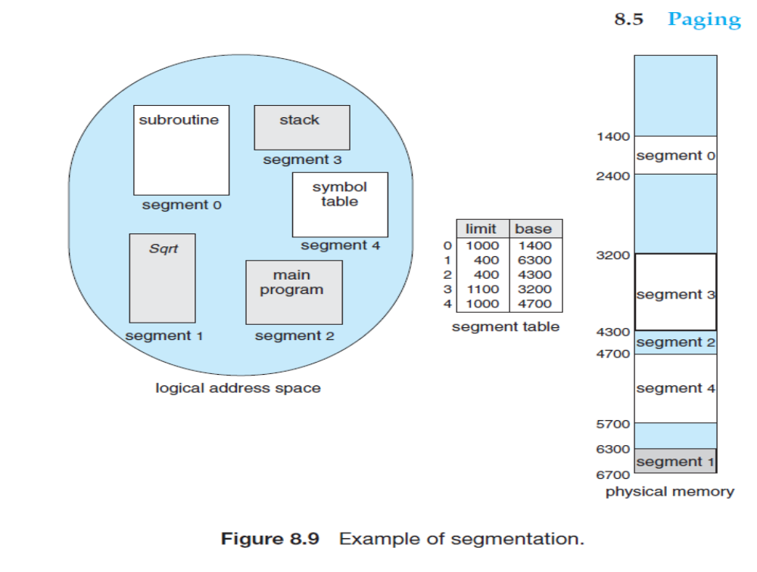

Slide 41
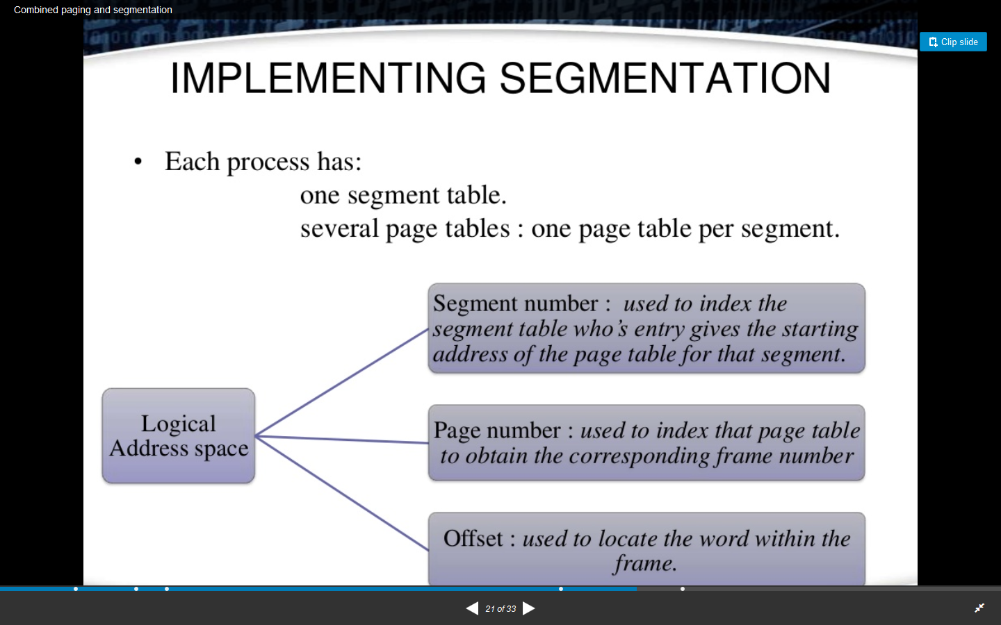

Slide 42
Virtual Memory
Virtual memory (VM) is a feature developed for the kernel of an operating system (OS) that simulates additional main memory such as RAM (random access memory) or disc storage.
This technique involves the manipulation and management of memory by allowing the loading and execution of larger programs or multiple programs simultaneously.
It also allows each program to operate as if it had infinite memory, and is often considered more cost effective than purchasing additional RAM.
Virtual memory permits software to use additional memory by utilizing the hard disc drive (HDD) as temporary storage.
Most central processing units (CPUs) provide memory management units (MMUs) that support virtual memory.
The MMU supports the “page tables” that are used to transform the “real” and “virtual” addresses located in memory and on the HDD.
An OS that uses virtual memory frees up space by transferring data from the HDD which is not immediately required.
When the data is needed, it is copied back to the HDD.
When all RAM is being used, VM swaps data to the HDD and then back again.
Thus, VM allows a larger total system memory; however, complicated code writing is required.

Slide 43
Paging
Segmentation permits the physical address space of a process to be noncontiguous.
Paging is another memory-management scheme that offers this advantage. However, paging avoids external fragmentation and the need for compaction, whereas segmentation does not.
The basic method for implementing paging involves breaking physical memory into fixed-sized blocks called frames and breaking logical memory into blocks of the same size called pages.
When a process is to be executed, its pages are loaded into any available memory frames from their source (a file system or the backing store).
The backing store is divided into fixed-sized blocks that are the same size as the memory frames or clusters of multiple frames. This rather simple idea has great functionality.
For example, the logical address space is now totally separate from the physical address space, so a process can have a logical 64-bit address space even though the system has less than 264 bytes of physical memory.

Slide 44
Page Data Structure
Every address generated by the CPU is divided into two parts: a page number (p) and a page offset (d).
The page number is used as an index into a page table.
The page table contains the base address of each page in physical memory.
This base address is combined with the page offset to define the physical memory address that is sent to the memory unit.

Slide 45

Address Translation Scheme
Address generated by CPU is divided into:
  Page number (p) – used as an index into a page table which contains base address of each page in physical memory
  Page offset (d) – combined with base address to define the physical memory address that is sent to the memory unit
  For given logical address space 2^{m} and page size 2^{n}

Slide 46

Paging Hardware

Slide 47

Paging Model of Logical and Physical Memory

Slide 48

Paging Example
n=2 and m=4 32-byte memory and 4-byte pages

Slide 49

Free Frames
Before allocation
After allocation

Slide 50
Structure of the Page Table
Memory structures for paging can get huge using straight-forward methods
  Consider a 32-bit logical address space as on modern computers
  Page size of 4 KB (2¹²)
  Page table would have 1 million entries (2³² / 2¹²)
  If each entry is 4 bytes -> 4 MB of physical address space / memory for page table alone
    That amount of memory used to cost a lot
    Don’t want to allocate that contiguously in main memory
Hierarchical Paging
Hashed Page Tables
Inverted Page Tables

Slide 51
Hierarchical Page Tables
Break up the logical address space into multiple page tables
A simple technique is a two-level page table
We then page the page table

Slide 52
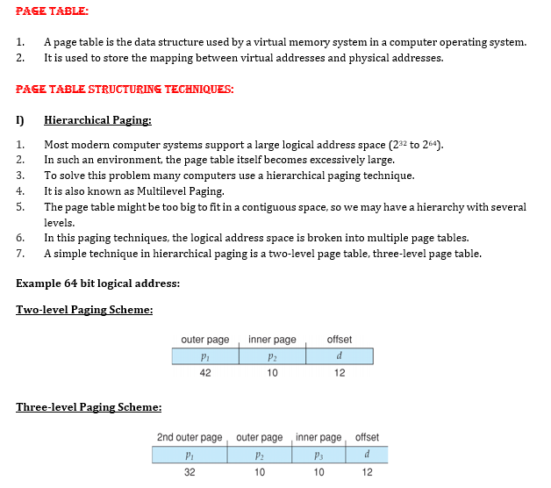


Slide 53

Two-Level Page-Table Scheme

Slide 54
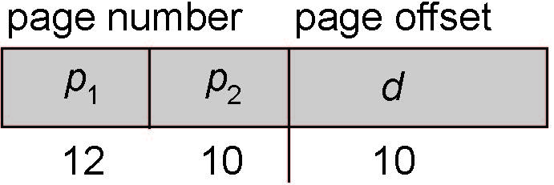
Two-Level Paging Example
A logical address (on 32-bit machine with 1K page size) is divided into:
  a page number consisting of 22 bits
  a page offset consisting of 10 bits
Since the page table is paged, the page number is further divided into:
  a 12-bit page number
  a 10-bit page offset
Thus, a logical address is as follows:
where p₁ is an index into the outer page table, and p₂ is the displacement within the page of the inner page table Known as forward-mapped page table

Slide 55

Address-Translation Scheme

Slide 56
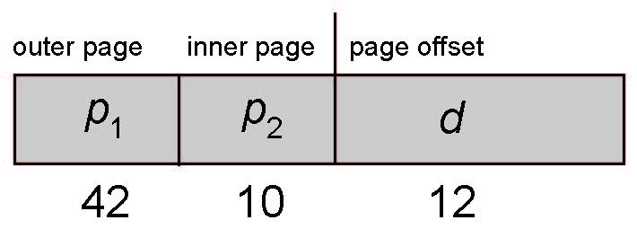
64-bit Logical Address Space
Even two-level paging scheme not sufficient
If page size is 4 KB (2¹²)
  Then page table has 2⁵² entries
  If two level scheme, inner page tables could be 2¹⁰ 4-byte entries
  Address would look like
  Outer page table has 2⁴² entries or 2⁴⁴ bytes
  One solution is to add a 2nd outer page table
  But in the following example the 2nd outer page table is still 2³⁴ bytes in size
    And possibly 4 memory access to get to one physical memory location

Slide 57
Hashed Page Tables
For handling address spaces larger than 32-bits we use hashed page table where has value is the virtual page number.
Every entry in the hashed table has a linked list of elements that hash to the same location
The linked list element has three fields
  The virtual page number
  Value of mapped page-frame
  Pointer to next element
Working: The virtual page number in the virtual address is hashed into the table.
Now, this virtual page number is compared with field 1 of the first element of the linked list.
If there is a match, the next page frame (field 2) is used to form the desired physical address.
If the matching failed, then the next entries in the linked list are searched to find the matching pair.

Slide 58

Hashed Page Table

Slide 59
Inverted Page Table
An alternate approach is to use the Inverted Page Table structure that consists of one page table entry for every frame of the main memory.
So the number of page table entries in the Inverted Page Table reduces to the number of frames in physical memory and a single page table is used to represent the paging information of all the processes.
Through inverted page table, the overhead of storing an individual pagetable for every process gets eliminated and only a fixed portion of memory is required to store the paging information of all the processes together.
This technique is called as inverted paging as the indexing is done with respect to the frame number instead of the logical page number

Slide 60

Inverted Page Table Architecture

Slide 61
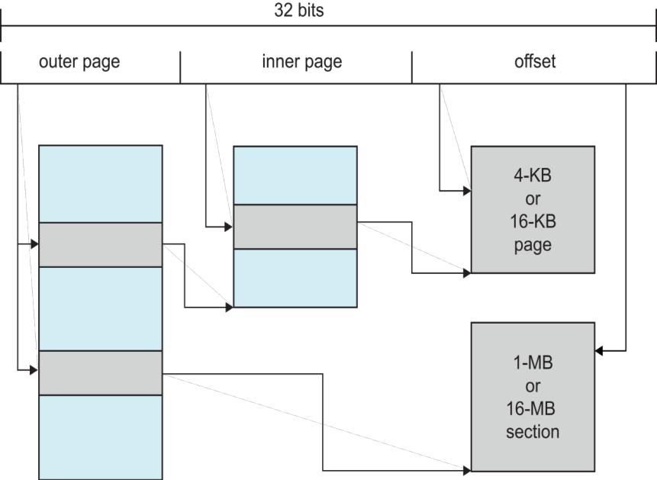
Example: ARM Architecture
Dominant mobile platform chip (Apple iOS and Google Android devices for example)
Modern, energy efficient, 32-bit CPU
4 KB and 16 KB pages
1 MB and 16 MB pages (termed sections)
One-level paging for sections, two-level for smaller pages
Two levels of TLBs
  Outer level has two micro TLBs (one data, one instruction)
  Inner is single main TLB
  First inner is checked, on miss outers are checked, and on miss page table walk performed by CPU

Slide 62
Virtual Memory
A computer can address more memory than the amount physically installed on the system.
This extra memory is actually called virtual memory and it is a section of a hard disk that's set up to emulate the computer's RAM.
The main visible advantage of this scheme is that programs can be larger than physical memory.
Virtual memory serves two purposes.
First, it allows us to extend the use of physical memory by using disk.
Second, it allows us to have memory protection, because each virtual address is translated to a physical address.

Slide 63
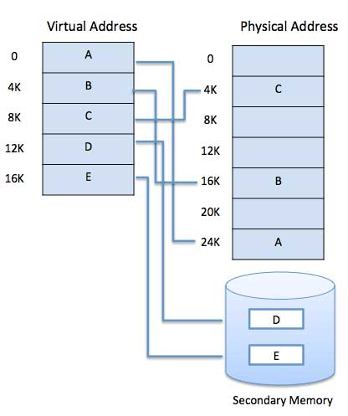
Modern microprocessors intended for general-purpose use, a memory management unit, or MMU, is built into the hardware.
The MMU's job is to translate virtual addresses into physical addresses. A basic example is given below −

Slide 64
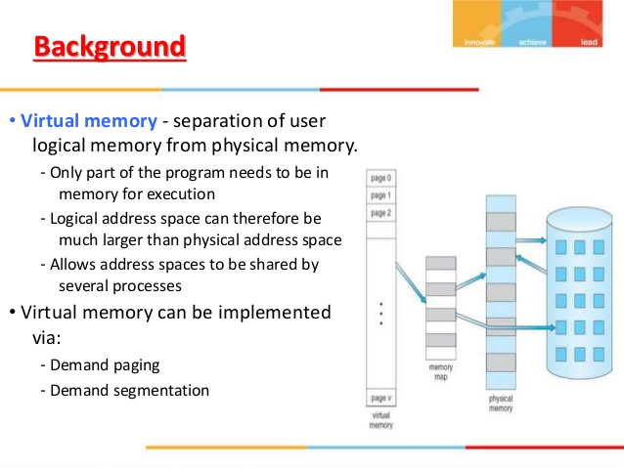

Slide 65
Demand Paging
A demand paging system is quite similar to a paging system with swapping where processes reside in secondary memory and pages are loaded only on demand, not in advance.
When a context switch occurs, the operating system does not copy any of the old program’s pages out to the disk or any of the new program’s pages into the main memory Instead, it just begins executing the new program after loading the first page and fetches that program’s pages as they are referenced.

Slide 66
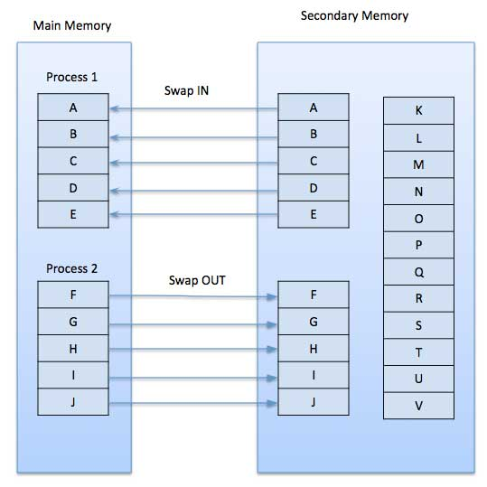

Slide 67
While executing a program, if the program references a page which is not available in the main memory because it was swapped out a little ago, the processor treats this invalid memory reference as a page fault and transfers control from the program to the operating system to demand the page back into the memory.
Advantages
Following are the advantages of Demand Paging −
Large virtual memory.
More efficient use of memory.
There is no limit on degree of multiprogramming.
Disadvantages
Number of tables and the amount of processor overhead for handling page interrupts are greater than in the case of the simple paged management techniques.

Slide 68
Page Replacement Algorithm
Page replacement algorithms are the techniques using which an Operating System decides which memory pages to swap out, write to disk when a page of memory needs to be allocated.
Paging happens whenever a page fault occurs and a free page cannot be used for allocation purpose accounting to reason that pages are not available or the number of free pages is lower than required pages.

Slide 69
When the page that was selected for replacement and was paged out, is referenced again, it has to read in from disk, and this requires for I/O completion.
This process determines the quality of the page replacement algorithm: the lesser the time waiting for page-ins, the better is the algorithm.

Slide 70
A page replacement algorithm looks at the limited information about accessing the pages provided by hardware, and tries to select which pages should be replaced to minimize the total number of page misses, while balancing it with the costs of primary storage and processor time of the algorithm itself.
There are many different page replacement algorithms.
We evaluate an algorithm by running it on a particular string of memory reference and computing the number of page faults.

Slide 71
Reference String
The string of memory references is called reference string.
Reference strings are generated artificially or by tracing a given system and recording the address of each memory reference.
The latter choice produces a large number of data, where we note two things.
For a given page size, we need to consider only the page number, not the entire address.
If we have a reference to a page p, then any immediately following references to page p will never cause a page fault. Page p will be in memory after the first reference; the immediately following references will not fault.
For example, consider the following sequence of addresses − 123,215,600,1234,76,96
If page size is 100, then the reference string is 1,2,6,12,0,0

Slide 72
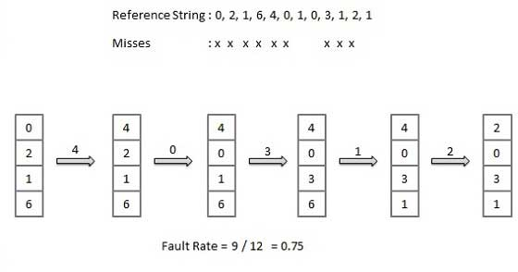
First In First Out (FIFO) algorithm
Oldest page in main memory is the one which will be selected for replacement.
Easy to implement, keep a list, replace pages from the tail and add new pages at the head.

Slide 73
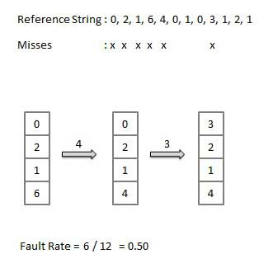
Optimal Page algorithm
An optimal page-replacement algorithm has the lowest page-fault rate of all algorithms. An optimal page-replacement algorithm exists, and has been called OPT or MIN.
Replace the page that will not be used for the longest period of time. Use the time when a page is to be used.

Slide 74
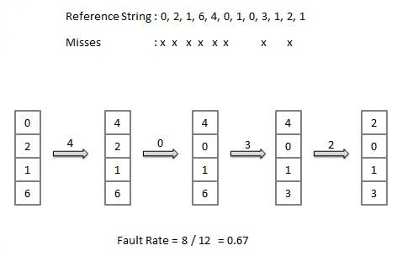
Least Recently Used (LRU) algorithm
Page which has not been used for the longest time in main memory is the one which will be selected for replacement.
Easy to implement, keep a list, replace pages by looking back into time

Slide 75
Thrashing
THRASHING :- If it happens that your system has to swap pages at such a higher rate that major chunk of CPU time is spent in swapping then this state is known as thrashing.
So effectively during thrashing, the CPU spends less time in some actual productive work and more time in swapping.
Memory thrashing is a problem which arises when the memory is located more than the physical memory and it is not available.
Now the effects of thrashing and also the extent to which thrashing occurs will be decided by the type of page replacement policy.
If the process does not have number of frames it needs to support pages in active use, it will quickly page-fault. The high paging activity is called thrashing.
In other words we can say that when page fault ratio decreases below level, it is called thrashing.

Slide 76
Allocating Kernel Memory
When a process running in user mode requests additional memory, pages are allocated from the list of free page frames maintained by the kernel.
Remember, too, that if a user process requests a single byte of memory, internal fragmentation will result, as the process will be granted an entire page frame.
Kernel memory is often allocated from a free-memory pool different from the list used to satisfy ordinary user-mode processes.
There are two primary reasons for this:
1.The kernel requests memory for data structures of varying sizes, some of which are less than a page in size.
As a result, the kernel must use memory conservatively and attempt to minimize waste due to fragmentation.
This is especially important because many operating systems do not subject kernel code or data to the paging system.
2. Pages allocated to user-mode processes do not necessarily have to be in contiguous physical memory.
However, certain hardware devices interact directly with physical memory—without the benefit of a virtual memory interface—and consequently may require memory residing in physically contiguous pages.

